Slide 1
IT752 WSC - Mini-project Evaluation [Jan-May 2023]
A Multilayered Informative Random Walk for Attributed Social Network Embedding
Guided By –
Dr. Somya Kamath
Presented By:
Man Mohan Nayak (222IT019)
Nikhil Verma (222IT026)

Slide 2
Introduction
Social Network Embedding is a technique used in machine learning to represent the nodes or entities of a social network as low-dimensional vectors or embedding. These embedding capture the structural and relational information of the social network and can be used for a variety of downstream tasks such as node classification, link prediction, and community detection.
The basic idea behind social network embedding is to learn a mapping from the high-dimensional space of the social network to a low-dimensional space where the nodes can be represented as vectors. This mapping is learned through various optimization techniques such as neural networks, matrix factorization, or random walks. The resulting embedding preserve the relationships between nodes in the original network, such as similarity, proximity, and connectivity.
Social network embedding has many applications in various fields such as social network analysis, recommendation systems, and fraud detection. It has been widely used in industry and academia, and has led to significant improvements in the performance of many social network-related tasks.

Slide 3
Literature Review
Authors/Year | Methodology | Advantages | Limitations
Jiaxuan You, Rex Ying, and Jure Leskovec/ 2019 | Proposes a positional aware GNN architecture to encode the position of each node in a graph. | Encodes the position of each node in the graph representation. | May not generalize well for graph with different topologies or node distributions.
Brian Gallagher and Tina Eliassi-Rad/ 2010 | Updates the labels of the nodes based on the labels of their neighbour and the label independent feature vector. | Leverages label independent features for classification. | Computationally expensive when applied to large-scale networks.
Daixin Wang, Peng Cui, and Wenwu Zhu /2016 | Deep neural network takes as input adjancency matrix and outputs a low dimensional vector. | Low dimensional representation of complex network that can capture both local and global structural properties. | Consider only the link structure of the network.

Slide 4
Outcome of literature review.
Methods to encode the position of the nodes in the graph representation.
A complex network can be represented as low dimensional vector and still captures local and global properties.

Slide 5
Problem Statement & Objective
Given G, the task is to find some low dimensional vector representation of the nodes of G which is consistent with both the structure of the network and the content of the nodes. More formally, for the given network G, the network embedding is to learn a function f : v_{i} → x_{i} ∈ R_{K}, i.e., it maps every vertex to a K dimensional vector, where K << min(n, d). The representations should preserve the underlying semantics of the network. Hence the nodes which are close to each other in terms of their positional distance or similarity in content should have similar representation.
Objectives:
Generate high-quality node embedding
Preserve the local and global network structure
Handle large-scale networks
Incorporate structural and attribute information

Slide 6
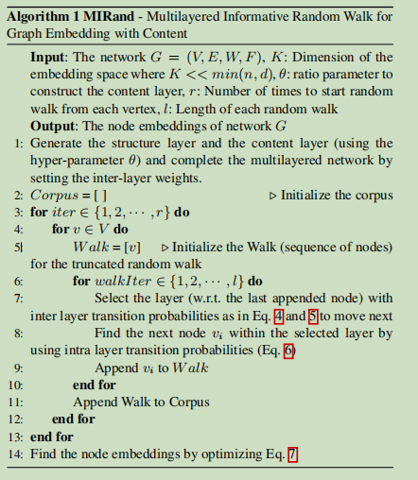
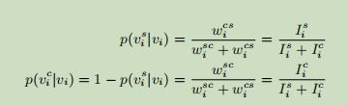
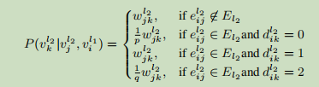

Methodology
Algorithm
Formula

Slide 7


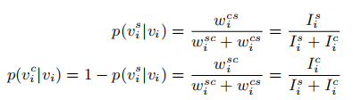
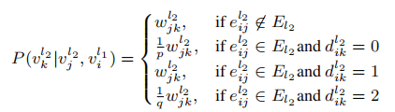
cont..
1st step:
construct structural layer (same as original network without content information ) and content layer ( calculating the cosine similarity among nodes ) eliminate edges with -ve similarity values .
2 nd step:
calculate the imformativeness of each node using below formula
3rd step: at each vertex we have to choose structural layer or content layer based on inter-layer transition probability value which is defined by
4th step: after selecting layer we have select next node using max probability

Slide 8
Dataset statistics
The Cora dataset consists of 2708 scientific publications classified into one of seven classes. The citation network consists of 5429 links. Each publication in the dataset is described by a 0/1-valued word vector indicating the absence/presence of the corresponding word from the dictionary. The dictionary consists of 1433 unique words.

Slide 9
Exploratory Data Analysis
Average Degree – 4.07
Degree Distribution – Pareto distribution
Average path length – 0.19
Diameter – 19
Average Clustering coefficient – 0.11
Number of strongly connected component – 2485
K connectedness = 1,2
Giant Component –
Average shortest path length – 2.54
Diameter – 4
Average CC – 0.015

Slide 10
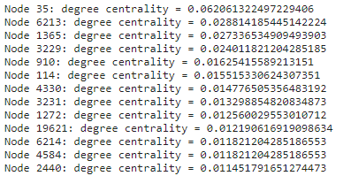
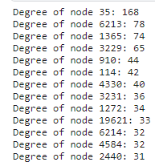
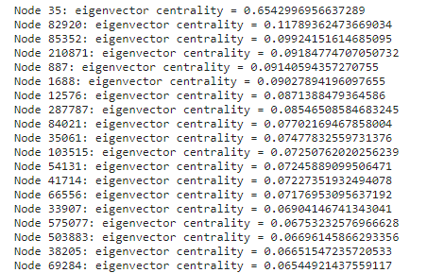
Exploratory Data Analysis
Important nodes – nodes that have high number of citations.
Powerful nodes – node that have high influence on other nodes.

Slide 11
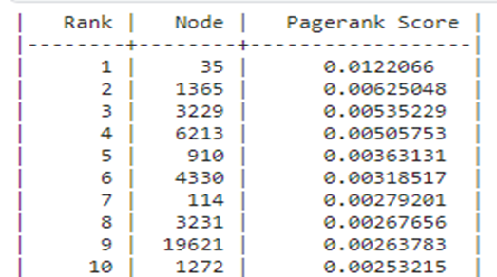
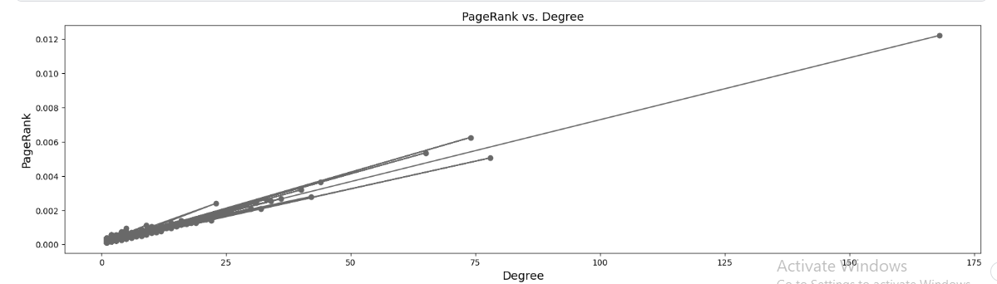
Exploratory Data Analysis
Prestigious Nodes -Prestigious nodes in a citation network are those that are cited by other important nodes, indicating that they have a high reputation in the research field.

Slide 12
Work done
Create a graph using structural and content attributes.
Generate walk by switching to content or structure layer based on the transition probability.
using Word2Vec for generating the embedding of each node.
Node visualization based on the generated embedding.
Node classification based on generated embedding.
Result:
Word2Vec object consisting of embedding of nodes in the network.
The node embeddings can be used for downstream task such as node classification, community detection etc.

Slide 13
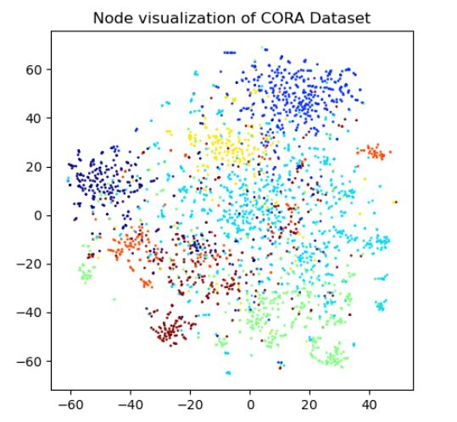
Results
1. t-SNE node visualization for evaluating our model first we are performing network graph visualization in this we differentiate node in communities in the graph network. for this task the embedding created by MIRand followed by word2vec model, in which each node attribute is represented by a 1 X 128 dimension vector.

Slide 14
Results
Node classification task for this task we have used the embedding created by random walk using MIRand as the dataset. the cora dataset contains publication of 6 classes namely – genetic algorithm, neural network, probabilistic methods, case based, reinforcement learning, and rule learning.
for training and testing the classifier model we have use different split of dataset from 10 % for training and 90% for testing to 90 % for training and 10 % for testing. The highest accuracy we got for training size 80 % and test data size 20 %. we got classification accuracy of 78.04% which is better than most baseline algorithms.

Slide 15
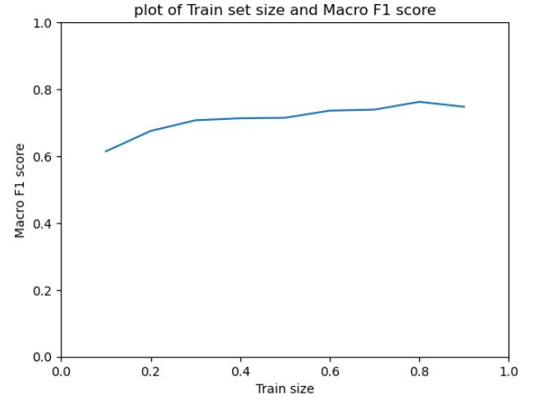
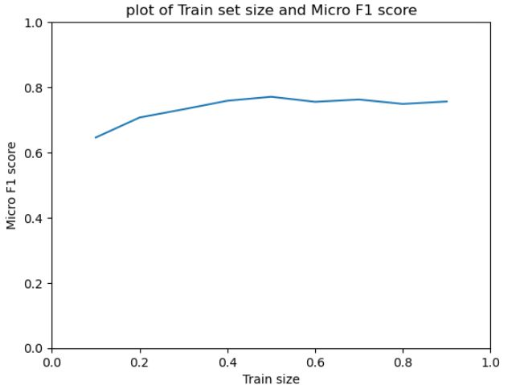
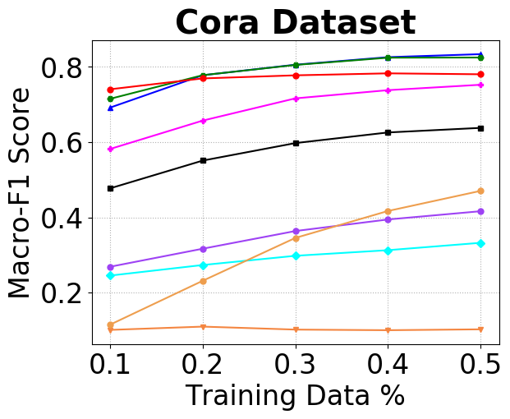
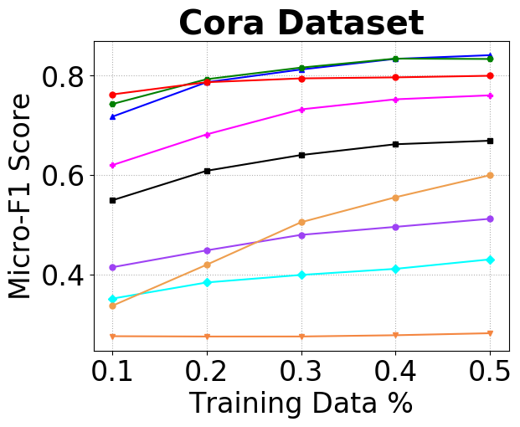
Results and comparison
Plot of Macro F1 score and Micro F1 score :

Slide 16
Conclusion
we have also plotted Macro F1 score and Micro F1 score with percent of data used for training. in the plot we observe very good results that are better than SDNE, AANE, GraphSAGE, Struc2Vec, DGI embedding technique using only the link structure layer for graph embedding.
future work – in the implementation we have used link structure layer and one attribute layer. as network node can many attributes to take then into account in creating the node embedding we can use multiple attribute layer for generating random walk. using multiple attribute layer we will model real world network more accurately.

Slide 17
References
[1] William L Hamilton, Rex Ying, and Jure Leskovec, ‘Representa
tion learning on graphs: Methods and applications’, arXiv preprint
arXiv:1709.05584, (2017).
[2] Daixin Wang, Peng Cui, and Wenwu Zhu, ‘Structural deep network
embedding’, in Proceedings of the 22nd ACM SIGKDD international
conference on Knowledge discovery and data mining, pp. 1225–1234.
ACM, (2016).
[3] Brian Gallagher and Tina Eliassi-Rad, ‘Leveraging label-independent
features for classification in sparsely labeled networks: An empirical
study’, in Advances in Social Network Mining and Analysis, 1–19,
Springer, (2010).
Dataset: https://linqs.soe.ucsc.edu/data

Slide 18
Thank You

